Slide 1
Business & Marketing, Digital Marketing & Social Media, & Economics
Mrs. Schafer

Slide 2
Workplace Etiquette

Slide 3
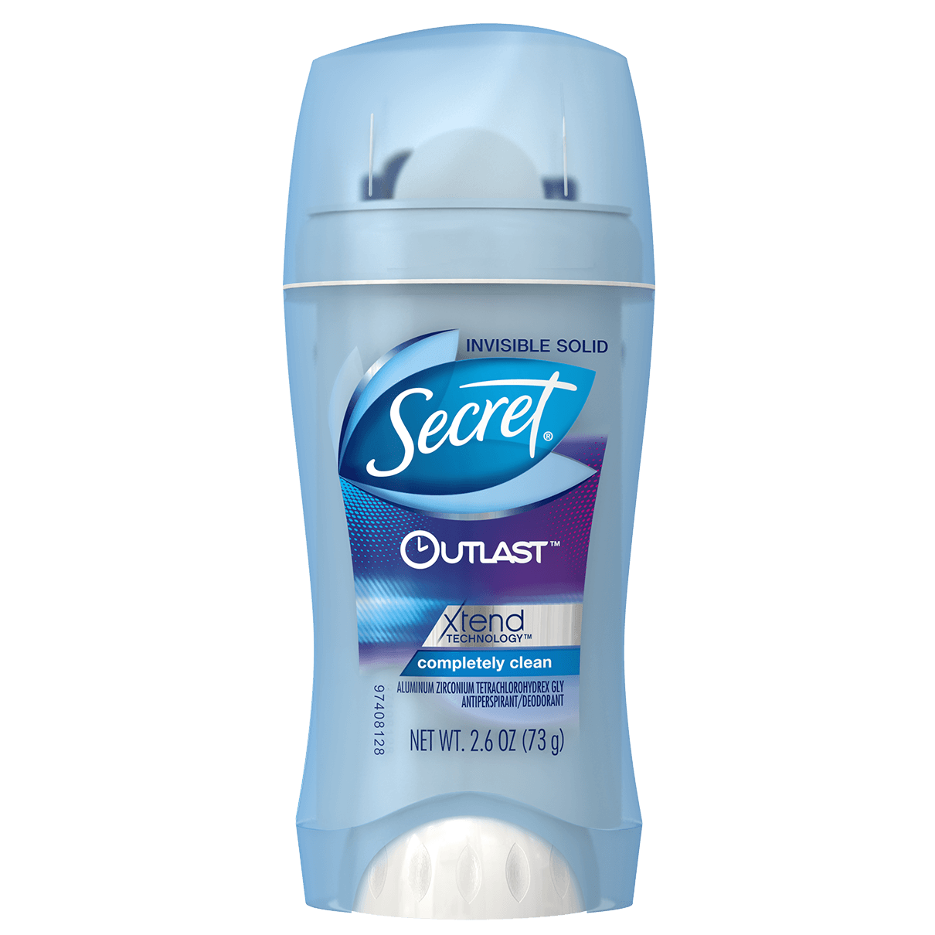
Hygiene at work
Shower once a day
Wash hair so that it doesn’t look greasy or smell bad
Wear deodorant, possibly with antiperspirant
Brush and floss
Mouthwash
Tongue scraper
Beard maintenance, no food caught in there
Brush hair, look at the back of it in a mirror
This Photo by Unknown Author is licensed under CC BY-NC

Slide 4
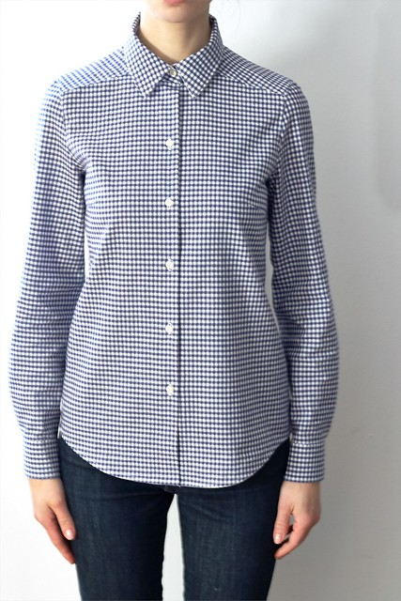
Clothing
No gaps between front buttons of shirt (no bras showing through, no chest hair, etc.) Wear a white tshirt or tank top underneath if there are gaps
No skin (stomach, pecs, biceps) showing at work. Thus, no crop tops or men’s tanktops
Not too tight of clothes (don’t want to see the outline of anything in the front or back!)
Not too low cut of shirts
No socks in crocks (no crocks at all)
This Photo by Unknown Author is licensed under CC BY-SA-NC

Slide 5

Food
No microwaving fish in the workplace kitchen/lounge
No microwaving popcorn…unless you’re prepared to share it with everyone who can smell it
This Photo by Unknown Author is licensed under CC BY-NC-ND

Slide 6
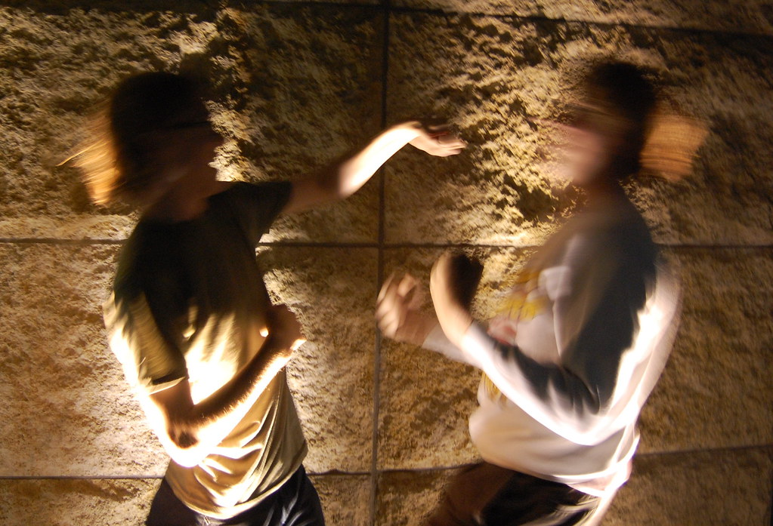
Touching
No touching except shaking hands
No massaging shoulders, sniffing hair, no patting someone on the top of the head
This Photo by Unknown Author is licensed under CC BY-SA

Slide 7
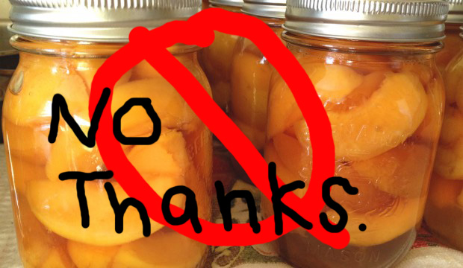
Comments
No commenting on whether a woman is pregnant or asking how far along she is. Can’t say anything about it until she’s made an open announcement or told you personally that she’s pregnant.
It could just be a sandwich
No commenting on any part of a person’s body. No complimenting body features
Can say: nice haircut, nice necklace, nice earrings, etc.
No calling coworkers any cutesy names like Peaches, Sugar, Dear, or Darling
This Photo by Unknown Author is licensed under CC BY

Slide 8

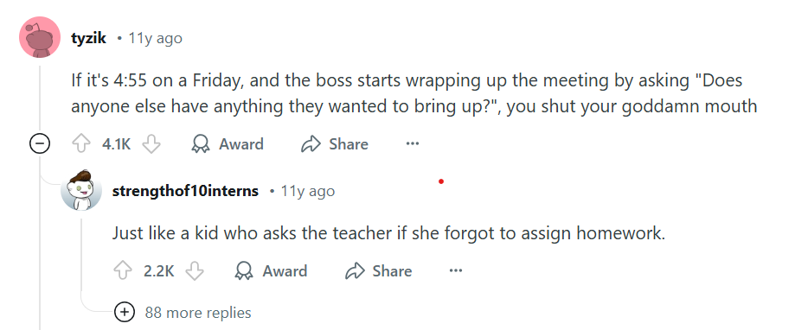
Be respectful of others’ space, belongings, and time
Can you walk into someone’s office if the door is closed but the person isn’t in there? How about if it’s open?
Be mindful of noise levels, especially in open office environments (assume everyone is listening…)

Slide 9
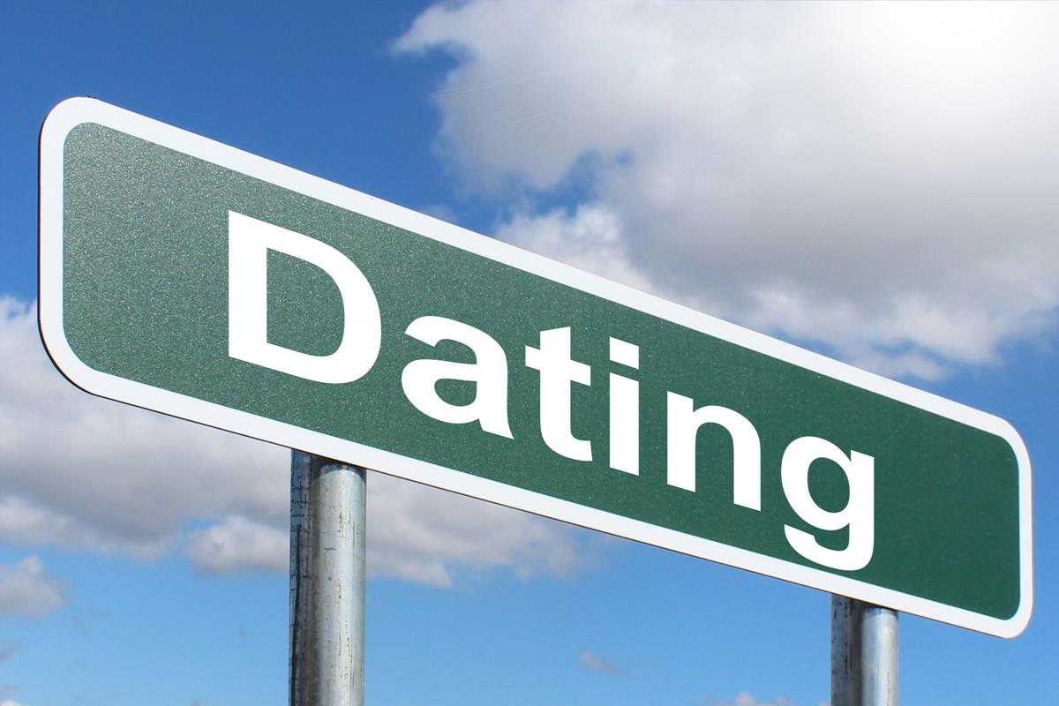
Dating
If you’re the boss can you date anyone who works for you?
Can you date a coworker if neither of you work for the other person?
Create a record with Human Resources

Slide 10
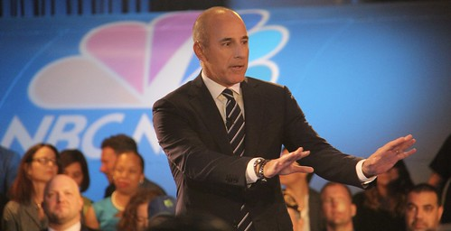
Activity 1: In groups of 3, research one person in history who was fired for inappropriate conduct at work
Who is the person?
What company did they work for?
What did they do?
How did they get found out?
What happened to them?
Summarize this into ONE slide.

